Slide 1
“Compiler Design
_{Unit 7}
Code Generation

Slide 2
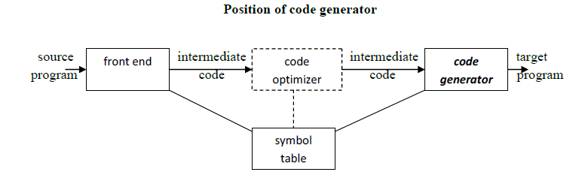
Introduction
The final phase in compiler model is the code generator.
It takes as input an intermediate representation of the source program and produces as output an equivalent target program.
The code generation techniques presented below can be used whether or not an optimizing phase occurs before code generation.

Slide 3
Issues In The Design Of A Code Generator
The following issues arise during the code generation phase :
1. Input to code generator
2. Target program
3. Memory management
4. Instruction selection
5. Register allocation
6. Evaluation order

Slide 4
Input to code generator
What it is: The code generator receives the program as an Intermediate Representation (IR) from earlier compiler stages.
This IR is the compiler's internal plan, not the original source code.
Examples of IR: This plan could be:
  Three-Address Code: Like t1 = a + b.
  Syntax Trees/DAGS: Tree structures showing calculations.
  Postfix Notation: Like a b+.
The Issue:
The code generator must be built to read and understand the specific IR format used. It also assumes this IR is correct (no errors like type mismatches).

Slide 5
Target program
What it is: The code generator's final output, which the computer will run. Output Options:
Absolute Machine Language: Raw binary code (0s and 1s) ready to run at a fixed memory location.
Relocatable Machine Language: Binary code where addresses aren't final. It includes extra info for a linker to combine it with other code (like libraries) and set the final addresses.
Assembly Language: Human-readable text code using commands like MOV, ADD. An assembler program is needed to turn this into machine code later. This output is specific to the CPU type.
The Issue: The designer must choose which output format to create. This choice impacts the generator's complexity and how the output code can be used (e.g., linking with libraries).

Slide 6
Memory management:
What it is: Figuring out the runtime memory address for each variable name used in the program.
The Issue:
The code generator uses the Symbol Table to find the variable's type, scope, and assigned offset (e.g., its position in a function's stack frame or in the static data area).
It must then generate instructions that correctly access memory using these addresses (e.g., MOV memory_address, Register or MOV Register, stack_offset(FramePointer)).
Getting these addresses wrong leads to incorrect program behavior.

Slide 7
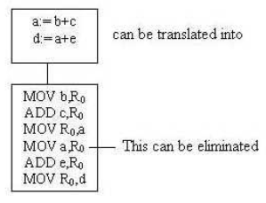
Instruction selection
What it is: Choosing the specific machine instructions to implement an IR operation. Often, there are multiple ways to do the same thing.
The Issue:
The goal is to pick instructions that are fast and result in small code size.
A poor choice leads to inefficient code.
It requires special handling. For example, the sequence of statements.

Slide 8
Register allocation
What it is: Deciding which variables or temporary results should be stored in the limited number of fast CPU registers.
The Issue:
Registers are much faster than main memory, but there are only a few. The code generator must:
Choose the best values to keep in registers (Allocation).
Assign specific registers (RO, R1, etc.) to these values (Assignment).
Handle situations where there aren't enough registers (potentially spilling values back to slower main memory).
Example: For d = (a+b) * (a+b), a good code generator would calculate a+b once, keep the result in a register, and then use that register to multiply it by itself, avoiding recalculation and extra memory access. A poor allocation might store a+b to memory and reload it.

Slide 9
Evaluation order
What it is: For some complex calculations, the order in which sub-parts are computed can be changed without changing the final answer.
The Issue:
Different orders might require different numbers of registers to hold intermediate results.
Example: For x = (a+b) + (c+d*e), the code generator could compute (a+b) first or (d*e) first. If computing (d*e) takes many registers, it might be better to compute (a+b), store it (perhaps even spill it if registers are full), then compute (c+d*e), and finally add the stored result.
Choosing the order that uses registers most efficiently is the challenge.

Slide 10
Approaches to Code Generation (Overall Goals)
Correctness: This is the absolute top priority. The generated code must work correctly.
Maintainability: The code generator itself should be well-designed, easy to understand, test, and update.

Slide 11
The Target Machine
Familiarity with the target machine and its instruction set is a prerequisite for designing a good code generator.
The target computer is a byte-addressable machine with 4 bytes to a word.
It has n general-purpose registers, R0, R1, . . . , Rn-1.
It has two-address instructions of the form:
op source, destination
where, op is an op-code, and source and destination are data fields.
It has the following op-codes :
MOV (move source to destination)
ADD (add source to destination)
SUB (subtract source from destination)
The source and destination of an instruction are specified by combining registers and memory locations with address modes.

Slide 12
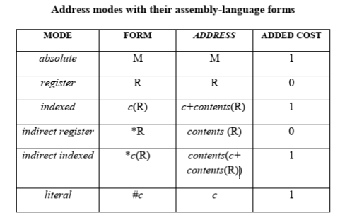
For example : MOV R0, M stores contents of Register R0 into memory location M ; MOV 4(R0), M stores the value contents(4+contents(R0)) into M.

Slide 13
Instruction costs :
Instruction cost = 1+cost for source and destination address modes.
This cost corresponds to the length of the instruction.
Address modes involving registers have cost zero.
Address modes involving memory location or literal have cost one.
Instruction length should be minimized if space is important.
Doing so also minimizes the time taken to fetch and perform the instruction.
For example : MOV R0, R1 copies the contents of register R0 into R1. It has cost one, since it occupies only one word of memory.

Slide 14
The three-address statement a : = b + c can be implemented by many different instruction sequences :
i) MOV b, R0 ADD c, R0 MOV R0, a cost = 6
ii) MOV b, a ADD c, a cost = 6
iii) Assuming R0, R1 and R2 contain the addresses of a, b, and c : MOV *R1, *R0 ADD *R2, *R0 cost = 2
In order to generate good code for target machine, we must utilize its addressing capabilities efficiently

Slide 15
Run-Time Storage Management
Information needed during an execution of a procedure is kept in a block of storage called an activation record, which includes storage for names local to the procedure.
The two standard storage allocation strategies are:
Static allocation
Stack allocation
In static allocation, the position of an activation record in memory is fixed at compile time.
In stack allocation, a new activation record is pushed onto the stack for each execution of a procedure.
The record is popped when the activation ends.

Slide 16
The following three-address statements are associated with the run-time allocation and de allocation of activation records:
Call
Return
Halt, and
Action, a placeholder for other statements.
We assume that the run-time memory is divided into areas for:
Code
Static data
Stack

Slide 17
Basic Block and Flow Graph
A basic block is a sequence of consecutive statements in which flow of control enters at the beginning and leaves at the end without any halt or possibility of branching except at the end.
Key Properties of a Basic Block
Single Entry Point – Execution starts only at the first instruction.
Single Exit Point – Control leaves only after the last instruction.
No Internal Branches – No jumps or branches occur within the block.
No Branch Targets – No jumps from outside enter in the middle of the block.

Slide 18
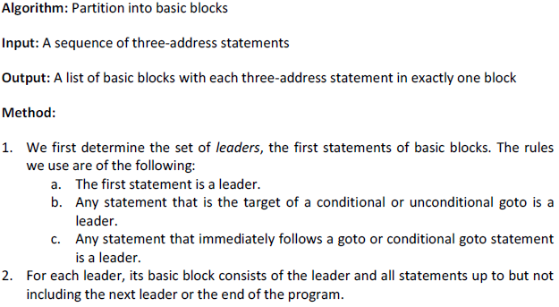
Basic Block Construction

Slide 19
Consider the following three-address code snippet:
1. x = 10
2. y = 20
3. if (x < y) goto 6
4. z = x + y
5. goto 7
6. z = x - y
7. print z

Slide 20
Leaders: Instructions 1, 4, 6, and 7
Basic Blocks:
Block 1: 1, 2, 3
Block 2: 4, 5
Block 3: 6
Block 4: 7

Slide 21
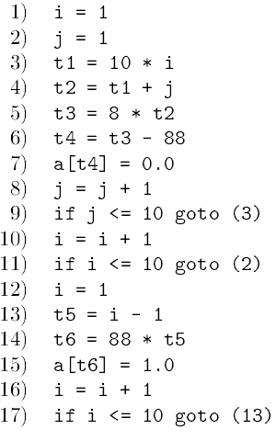

Slide 22
Find leaders and blocks

Slide 23
A flow graph (or control flow graph, CFG) is a graphical representation of a program's control structure, where nodes represent basic blocks and edges represent control flow between them. It is widely used in compiler optimizations, program analysis, and testing.
Structure of a Flow Graph
Nodes → Basic Blocks (sequences of instructions with no branches except at the end).
Edges → Possible execution paths (branches, jumps, fall-through).
Start Node → Entry block (first instruction).
End Node → Exit block (last instruction, may have multiple exits if there are return statements).

Slide 24
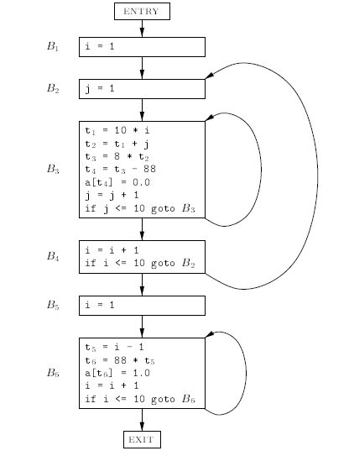

Slide 25
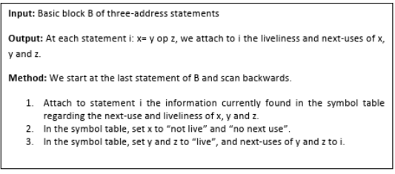
Next Use Information
If the name in a register is no longer needed, then we remove the name from the register and the register can be used to store some other names.

Slide 26
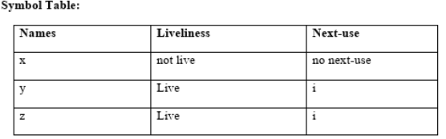

Slide 27
Simple Code Generator
A code generator generates target code for a sequence of three- address statements and effectively uses registers to store operands of the statements.
For example: consider the three-address statement a := b+c
It can have the following sequence of codes:
ADD Rj, Ri Cost = 1 // if Ri contains b and Rj contains c (or)
ADD c, Ri Cost = 2 // if c is in a memory location (or)
MOV c, Rj Cost = 3 // move c from memory to Rj and add
ADD Rj, Ri

Slide 28
Register and Address Descriptors:
A register descriptor is used to keep track of what is currently in each registers. The register descriptors show that initially all the registers are empty.
An address descriptor stores the location where the current value of the name can be found at run time.

Slide 29
A code-generation algorithm:
The algorithm takes as input a sequence of three-address statements constituting a basic block. For each three-address statement of the form x : = y op z, perform the following actions:
1. Invoke a function getregto determine the location L where the result of the computation y op z should be stored.
2. Consult the address descriptor for y to determine y‟, the current location of y. Prefer the register for y‟ if the value of y is currently both in memory and a register. If the value of y is not already in L, generate the instruction MOV y‟ , L to place a copy of y in L.

Slide 30
3. Generate the instruction OP z‟ , L where z‟ is a current location of z. Prefer a register to a memory location if z is in both. Update the address descriptor of x to indicate that x is in location L. If x is in L, update its descriptor and remove x from all other descriptors.
4. If the current values of y or z have no next uses, are not live on exit from the block, and are in registers, alter the register descriptor to indicate that, after execution of x : = y op z , those registers will no longer contain y or z.

Slide 31
Generating Code for Assignment Statements:
The assignment d : = (a-b) + (a-c) + (a-c) might be translated into the following three- address code sequence:
t : = a – b
u : = a – c
v : = t + u
d : = v + u
with d live at the end.
Code sequence for the example is:

Slide 32
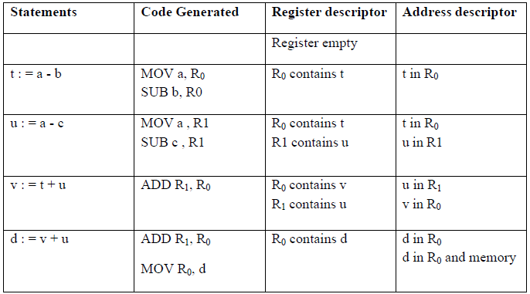

Slide 33
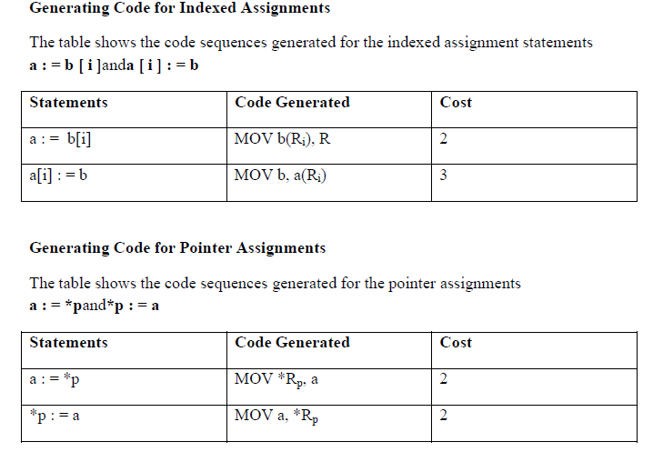

Slide 34
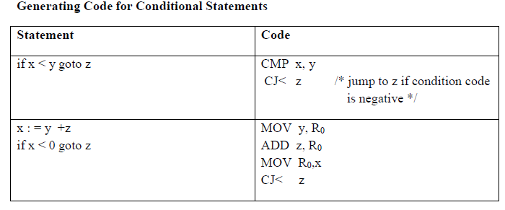

Slide 35
Register Allocation and Assignment
Instructions involving only register operands are faster than those involving memory operands.
On modern machines, processor speeds are often an order
of magnitude or more faster than memory speeds.
Therefore, efficient utilization of registers is vitally important in generating good code.
Various strategies for deciding at each point in a program what values should reside in registers (register allocation) and in which register each value should reside (register assignment).
One approach to register allocation and assignment is to assign specific values in the target program to certain registers.

Slide 36
For example, we could decide to assign base addresses to one group of registers, arithmetic computations to another, the top of the stack to a fixed register, and so on.
Local register allocation
Register allocation is only within a basic block. It follows top-down approach.
Assign registers to the most heavily used variables
Traverse the block
Count uses
Use count as a priority function
Assign registers to higher priority variables first

Slide 37
Global register allocation:
Local allocation does not take into account that some instructions (e.g. those in loops) execute more frequently.
It forces us to store/load at basic block endpoints since each block has no knowledge of the context of others.
To find out the live range(s) of each variable and the area(s) where the variable is used/defined global allocation is needed.
In compiler design, global register allocation refers to assigning variables to registers across basic blocks and loops, not just within a single block.
It’s a broader, more optimized form of register allocation compared to local allocation (which handles one block at a time).
Cost of spilling will depend on frequencies and locations of uses.

Slide 38
Register allocation depends on:
Size of live range
The number of instructions between a variable's definition and last use.
Number of uses/definitions
Total count of how often a variable is used or redefined in the code.
Frequency of execution
How often the code using the variable is executed (e.g., inside a loop vs. outside).
Number of loads/stores needed.
If a variable isn’t kept in a register, it must be loaded before use and stored after modification.
Cost of loads/stores needed
Memory access cost depends on architecture (e.g., cache misses, instruction latency).

Slide 39
Example
  for (int i = 0; i < 1000; i++) {
  x = x + y;
  z = x * 2;
  }
x: Used and defined often, Has a long live range across the loop, Lives in a high-frequency region (loop), Loading/storing each iteration is expensive. ⇒ Strong candidate for register allocation. | z: Defined but not reused ⇒ Short live range. ⇒ Weaker candidate (could be in memory).

Slide 40

Usage Counts:
Usage count is a metric used during register allocation to guide which variables (or temporaries) are most deserving of registers.
It reflects how often a variable is accessed (read or written) within a given region (typically a basic block, loop, or function).
An approximate formula for the benefit to be realized from allocating a register to x within a loop L is:
where,
-use(x, B) is the number of times x is used in B prior to any definition of x;
-live(x,B) is 1 if x is live on exit from B and is assigned a value in B and 0 otherwise.

Slide 41
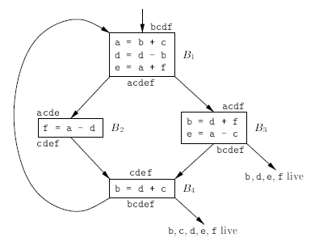
Example: Consider the basic block in the inner loop in Fig where jump and conditional jumps have been omitted. Assume R0, R1 and R2 are allocated to hold values throughout the loop. Variables live on entry into and on exit from each block are shown in the figure.
Fig: Flow graph of an inner loop

Slide 42
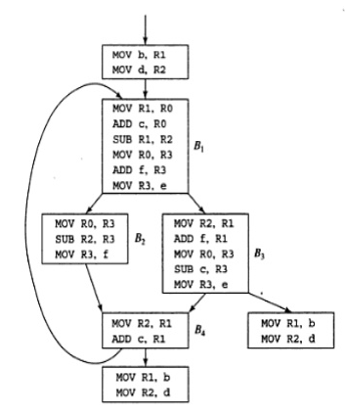
Fig : Code sequence using global register assignment () the assembly code generated from previous figure

Slide 43
Register Assignment for Outer Loops
Having assigned registers and generated code for inner loops, we may apply the same idea to progressively larger enclosing loops.
Inner loops execute more frequently (due to nesting), so variables used in them benefit the most from being held in registers.
If an outer loop L1 contains an inner loop L₂, the names allocated registers in L₂ need not be allocated registers in L1 — L2.
The lifetime of variables in L2 is typically shorter than those in L1.
If we choose to allocate x a register in L2 but not L1, we must load x on entrance to L2 and store x on exit from L2.

Slide 44
If variable x is:
Assigned a register in L2 but
Not in L1 (i.e., it lives in memory in L1), then:
Before entering L2: Load x from memory to its register.
After exiting L2: Store the updated value of x back to memory.
  for (i = 0; i < N; i++) { // Outer loop L1
  ... // x might be in memory
  for (j = 0; j < M; j++) { // Inner loop L2
  ... // x is heavily used, so put x in a register
  }
  ... // back to memory
  }
Compiler loads x into a register when entering L2.
Compiler stores x back to memory when exiting L2.
for i = 0 to N-1:
... ; x is in memory here
LOAD R1, x ; 🔹 Load before entering L2
for j = 0 to M-1:
R1 = R1 + ... ; 🔹 operate using register only
STORE x, R1 ; 🔹 Store after exiting L2
... ; x again treated as memory variable

Slide 45
Register Allocation by Graph Coloring
When a register is needed for a computation but all available registers are in use, the contents of one of the used registers must be stored (spilled) into a memory location in order to free up a register.
Graph coloring is a simple, systematic technique for allocating registers and managing register spills.
Register allocation by graph coloring is a widely used global register allocation technique in compilers.
It models the problem of assigning registers as a graph coloring problem, where:
Variables are nodes (vertices),
Edges represent interference (i.e., two variables that are live at the same time and cannot share a register),
Colors represent machine registers.

Slide 46
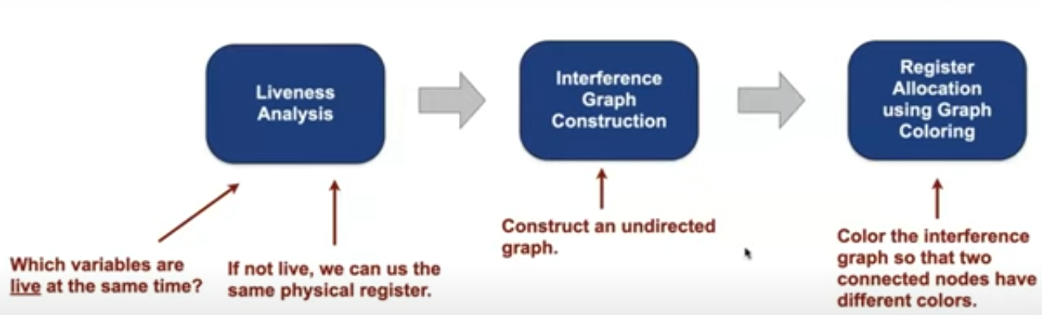

Slide 47
Basic idea
1. Identify the Live Range of Each Variable
A live range of a variable is the span of code where the variable holds a value that may be used in the future.
It starts at the definition and ends at the last use.
Use liveness analysis to determine which variables are live at each program point.
2. Build the Interference Graph
Nodes = Variables
Edge (A→ B) = A and B are live at the same time ⇒ conflict.
The graph represents interference between variables’ live ranges.
3. Color the Graph with k Colors
Try to assign colors (registers) to each node so that:
  No two adjacent nodes (interfering variables) have the same color.
  k = number of available physical registers on the target machine.

Slide 48
Assume 3 variables: a, b, c, and 2 registers: R1, R2
Liveness info:
a and b live together
b and c live together
a and c do not interfere (no edge)
Interference Graph:
a --- b --- c
This graph can be colored with 2 colors:
a → R1
b → R2
c → R1

Slide 49
The Dag Representation of Basic Blocks
A DAG for a basic block is a directed acyclic graph with the following labels on nodes:
Leaves are labeled by unique identifiers, either variable names or constants.
Interior nodes are labeled by an operator symbol.
Nodes are also optionally given a sequence of identifiers for labels to store the computed values.
DAGs are useful data structures for implementing transformations on basic blocks.
It gives a picture of how the value computed by a statement is used in subsequent statements.
It provides a good way of determining common sub- expressions

Slide 50
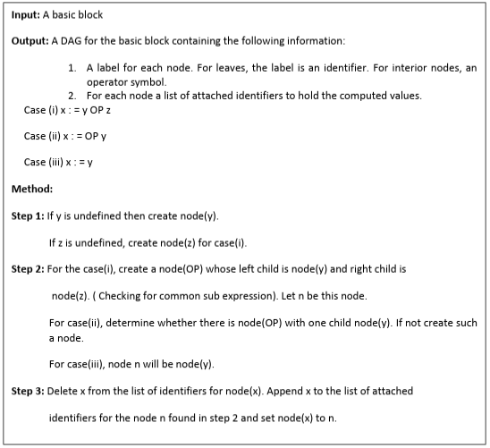
Algorithm for construction of DAG

Slide 51
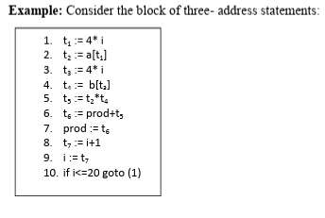

Slide 52
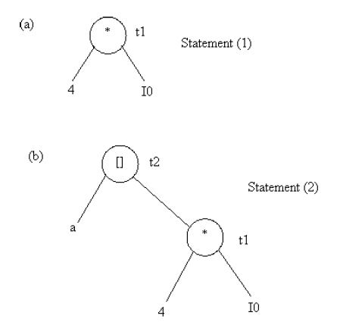

Slide 53
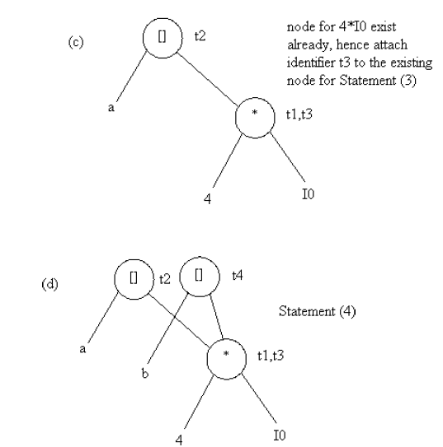

Slide 54
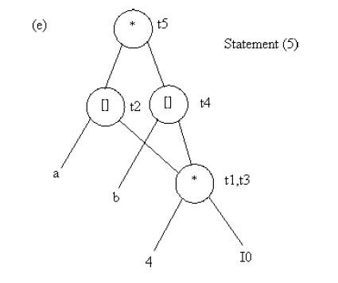

Slide 55
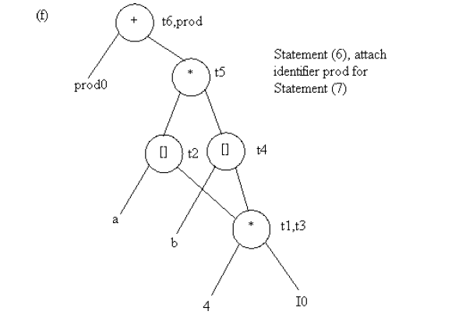

Slide 56
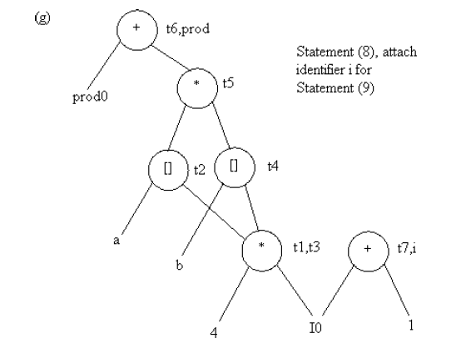

Slide 57
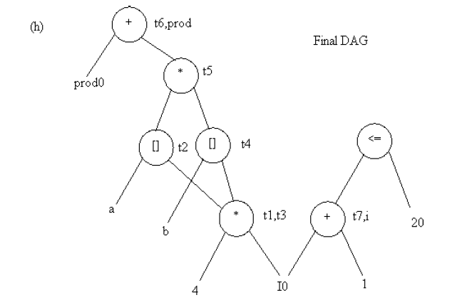

Slide 58
Generating Code from Dags
Generating code from a Directed Acyclic Graph (DAG) optimizes compiler intermediate code by rearranging computations within basic blocks to eliminate common sub-expressions and minimize register usage.
Techniques include topological sorting for ordering, heuristic reordering for efficiency, and labeling algorithms to determine optimal register allocation, ensuring efficient machine code generation.
The advantage of generating code for a basic block from its dag representation is that, from a dag we can easily see how to rearrange the order of the final computation sequence than we can starting from a linear sequence of three-address statements or quadruples.

Slide 59
Rearranging the order
A DAG identifies dependencies, allowing the compiler to reorder instructions to reduce the number of registers needed and simplify the overall code structure.
The order in which computations are done can affect the cost of resulting object code.
For example, consider the following basic block:
  t1 : = a + b
  t2 : = c + d
  t3 : = e – t2
  t4 : = t1 – t3

Slide 60
Generated code sequence for basic block:
    MOV a , R0
    ADD b , R0
    MOV c , R1
    ADD d , R1
    MOV R0 , t1
    MOV e , R0
    SUB R1 , R0
    MOV t1 , R1
    SUB R0 , R1
    MOV R1 , t4

Slide 61
Rearranged basic block:
Now t1 occurs immediately before t4.
t2 : = c + d
t3 : = e – t2
t1 : = a + b
t4 : = t1 – t3
Revised code sequence:
MOV c , R0
ADD d , R0
MOV a , R0
SUB R0 , R1
MOV a , R0
ADD b , R0
SUB R1 , R0
MOV R0 , t4
In this order, two instructions MOV R 0 , t1 andMOV t 1 , R1 have been saved.

Slide 62
Heuristic Ordering:
This method constructs the code by traversing the DAG, often by selecting nodes whose parents have already been listed, aiming to evaluate operators only after their operands are computed.

Slide 63
Labeling Algorithm:
The label represents the number of registers needed to evaluate that subtree without storing intermediate results in memory.
Nodes are labeled with the minimum number of registers required to evaluate them.
The algorithm prioritizes evaluating nodes that require more registers first to minimize register spilling.
Register spilling is a performance-degrading process where a compiler or hardware runs out of available CPU/GPU registers and moves active variables to slower memory.

